Slide 1
65% missing SNP filter – 50% missing individual filter

Slide 2
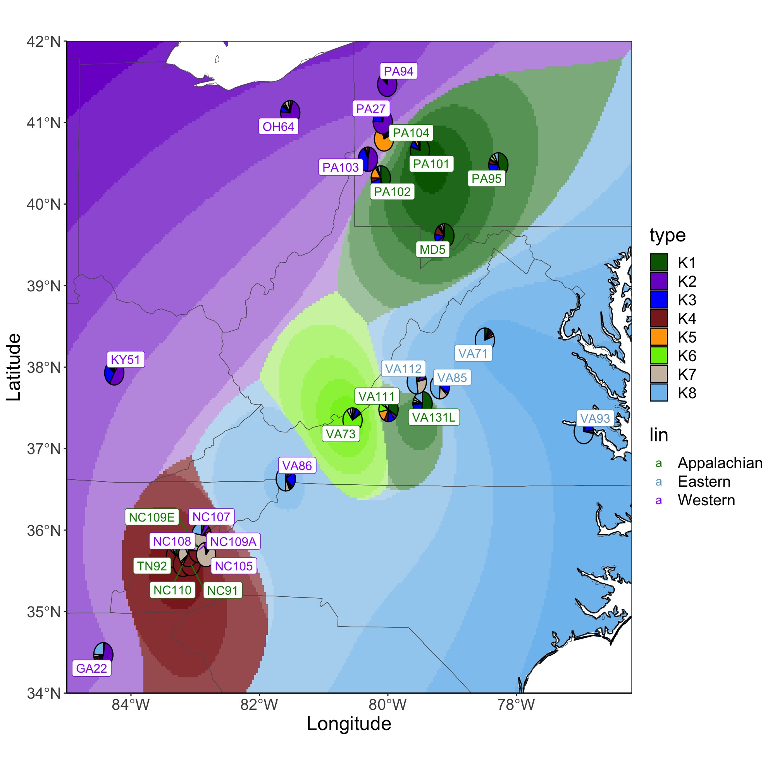
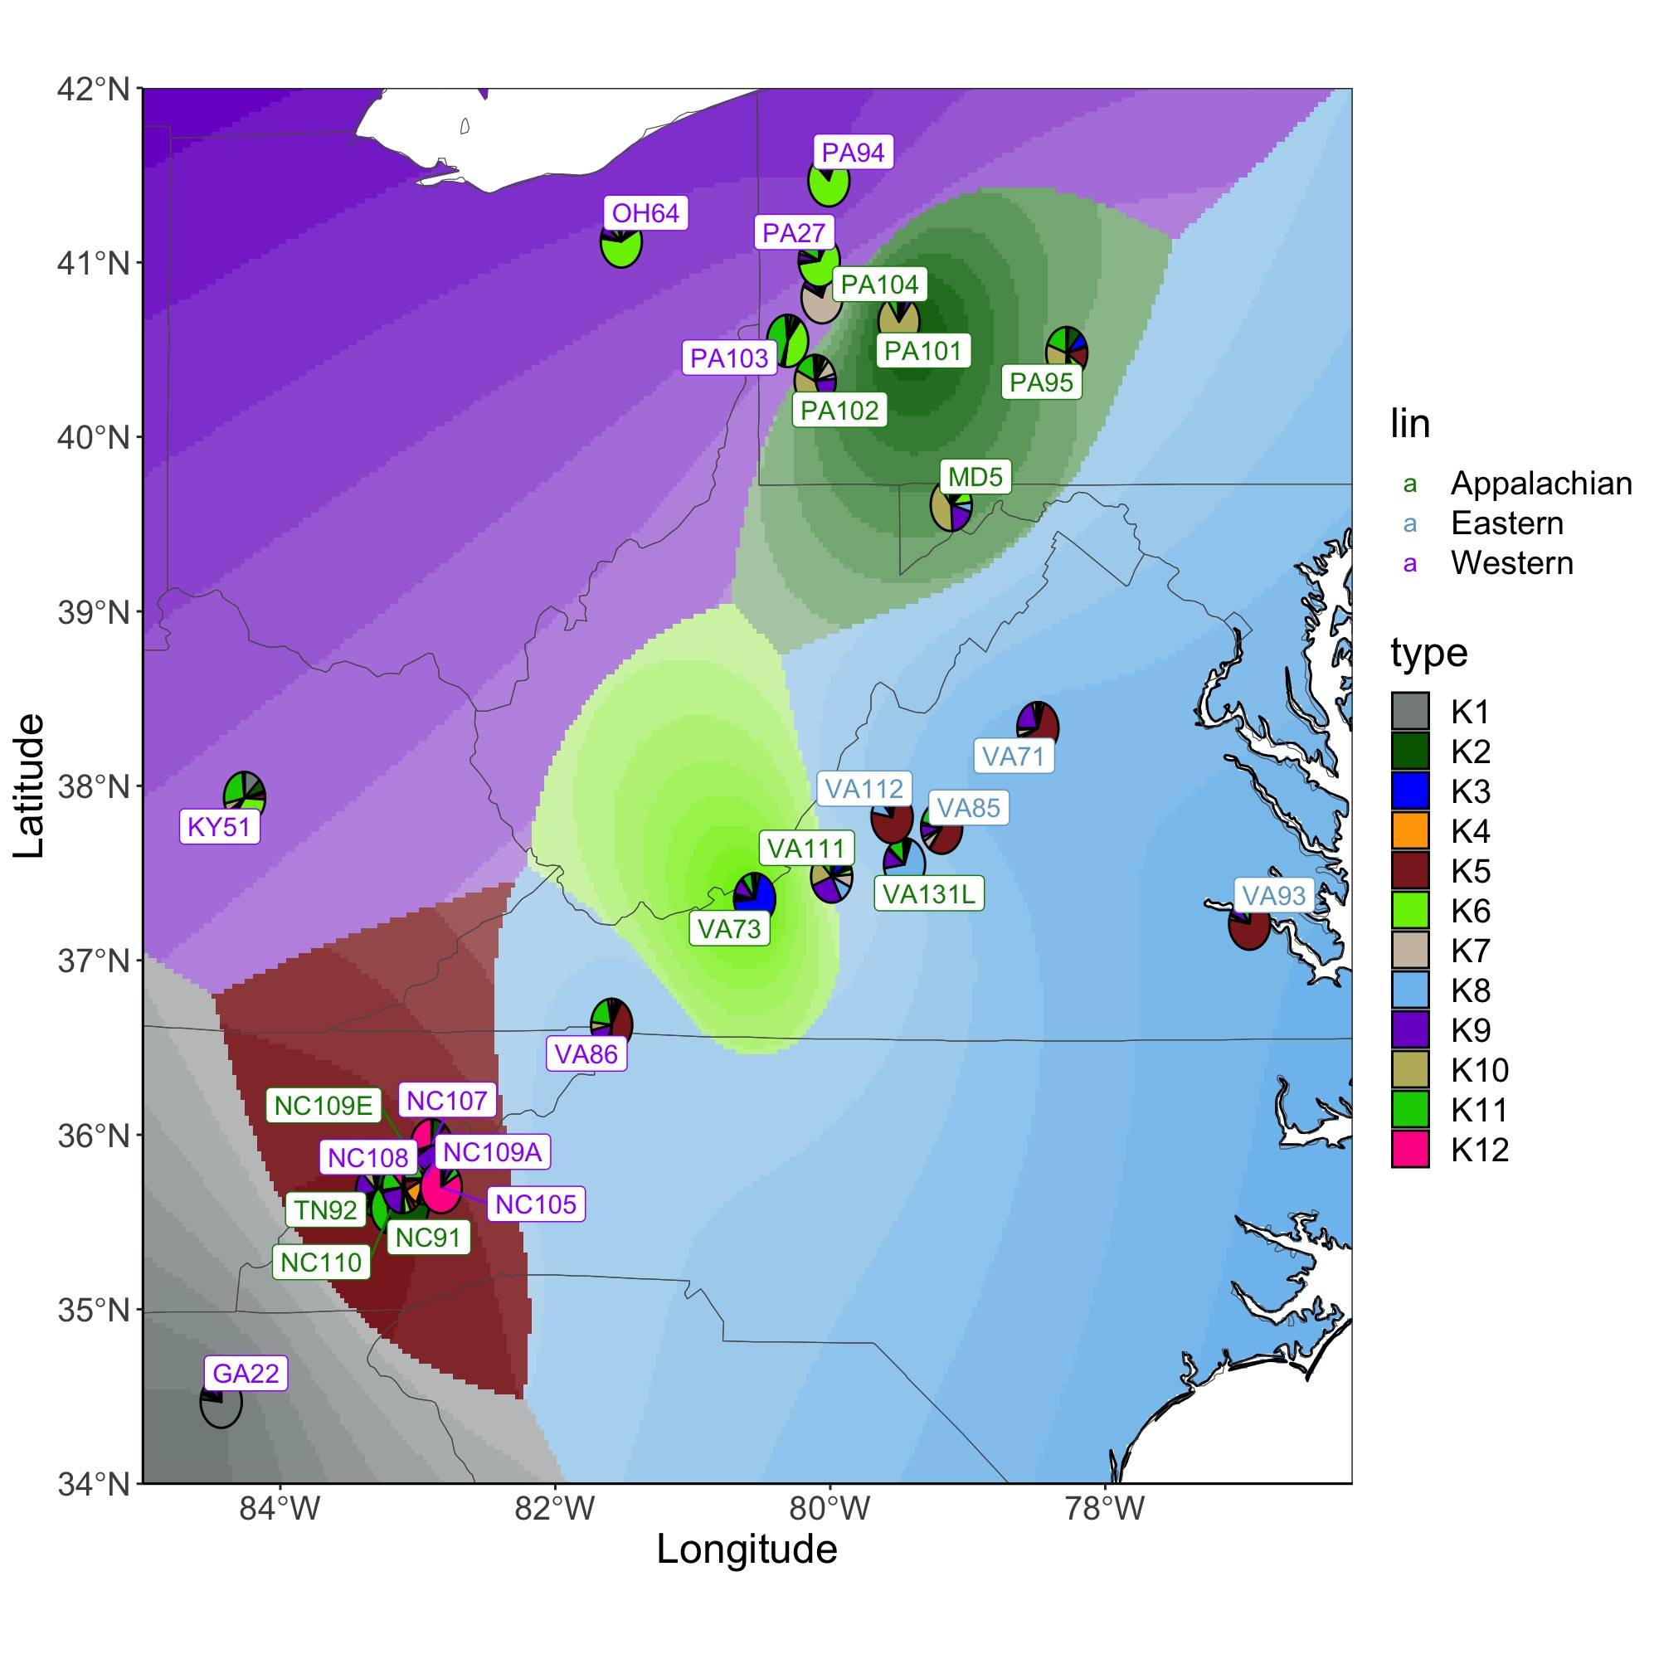
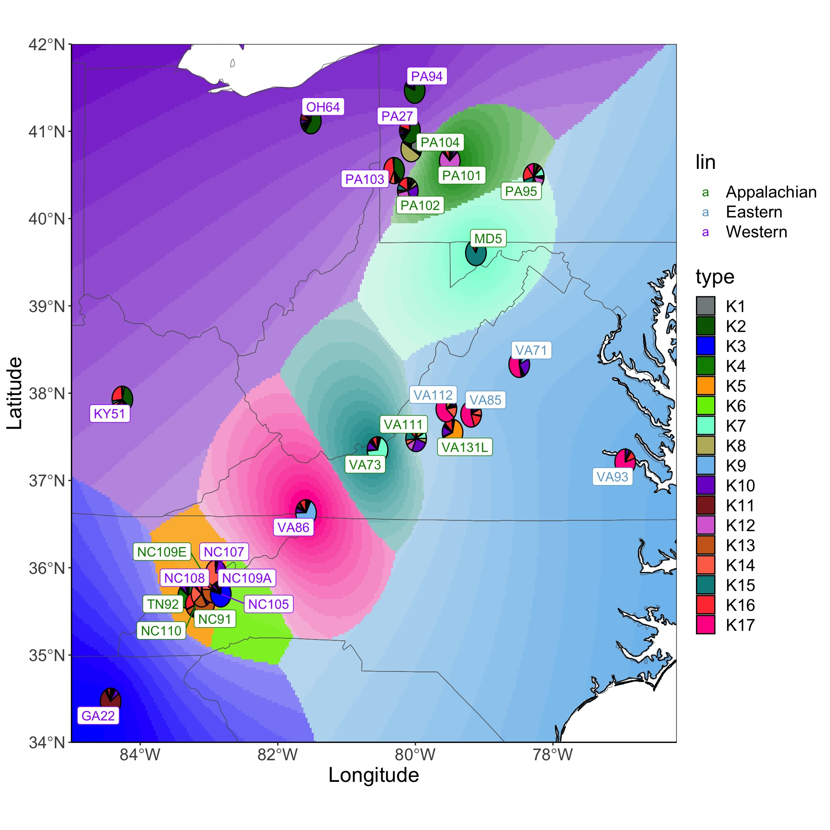
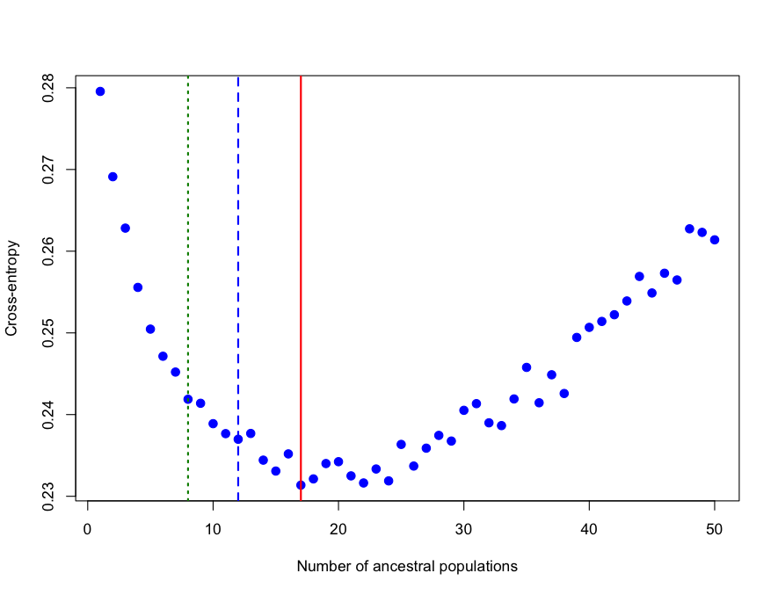
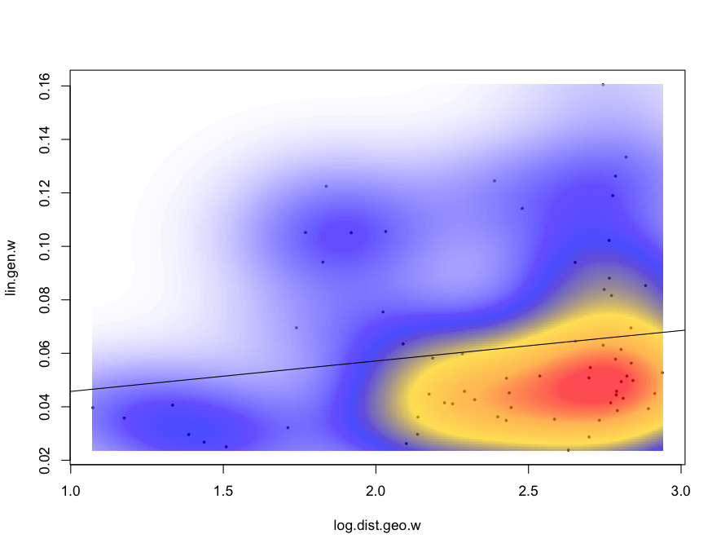
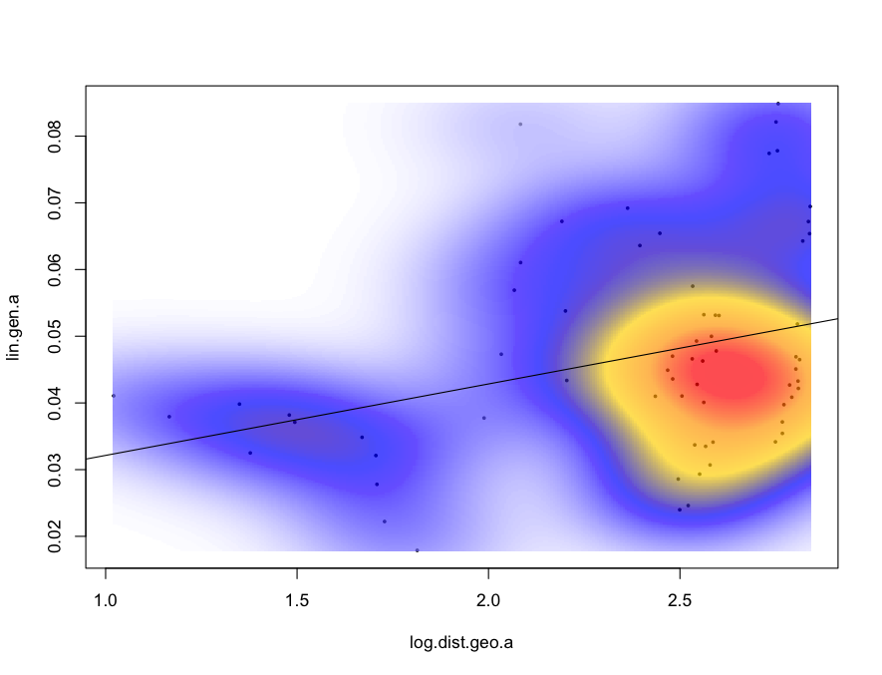
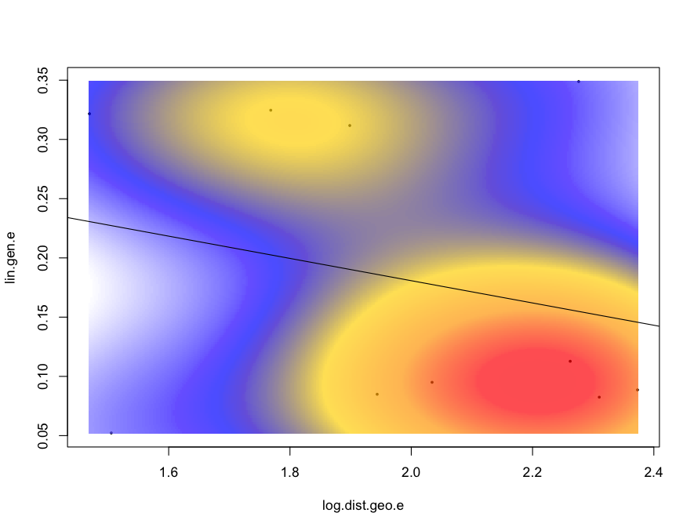
K=8
K=12
K=17
K-clusters
Western
Appalachian
Eastern
p=0.19
p=0.01
p=0.70
Linearized genetic distance
Log10(geographic distance)

Slide 3
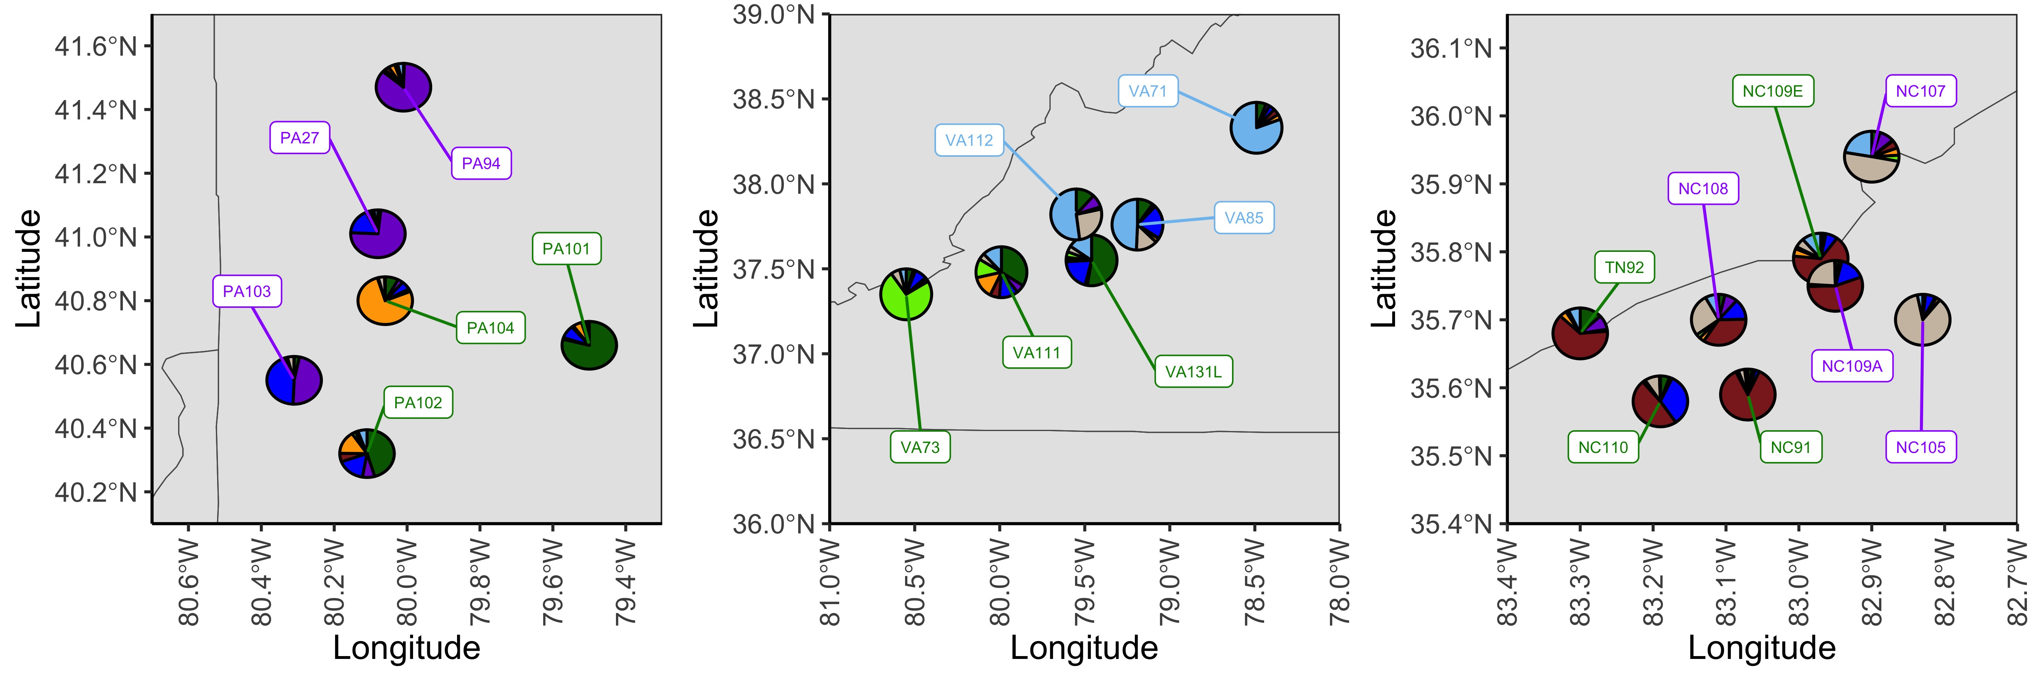
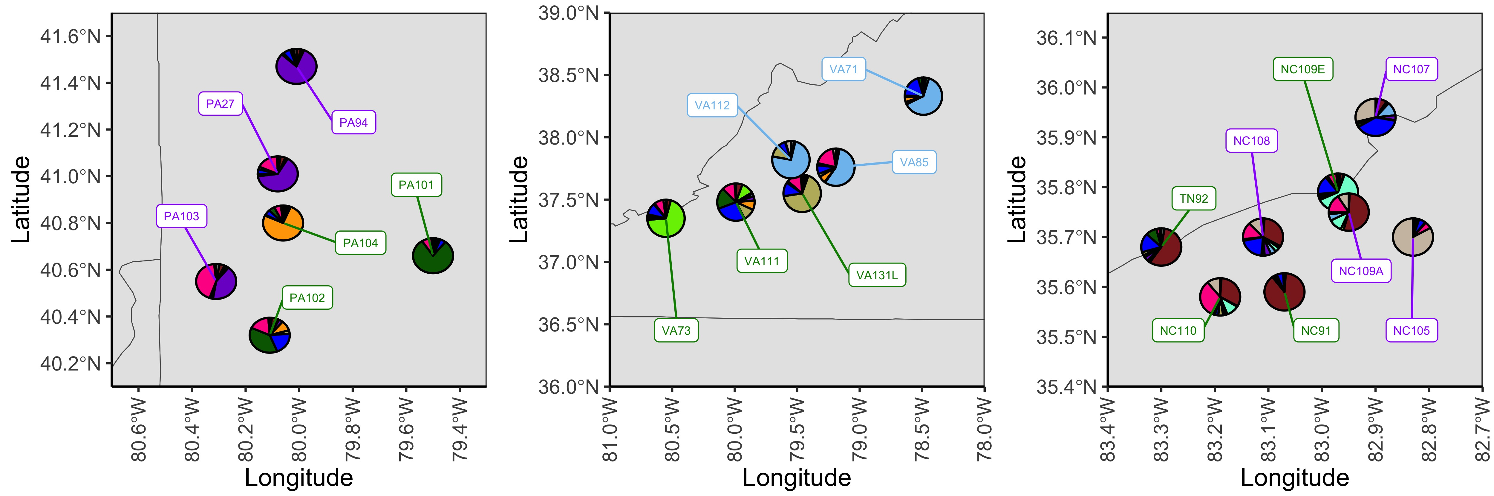
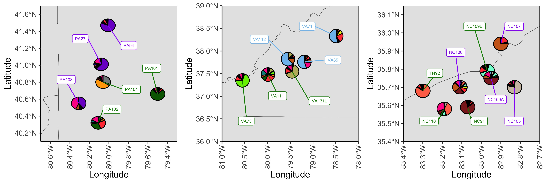
K-clusters
K=8
K=12
K=17

Slide 4
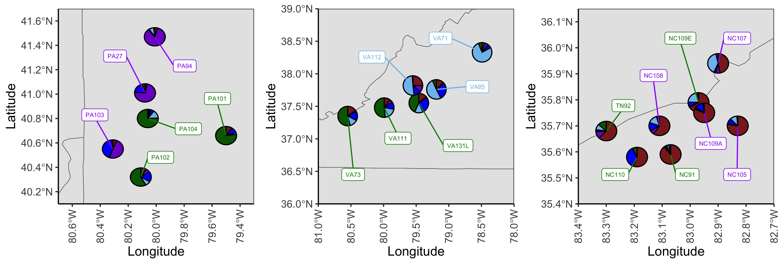
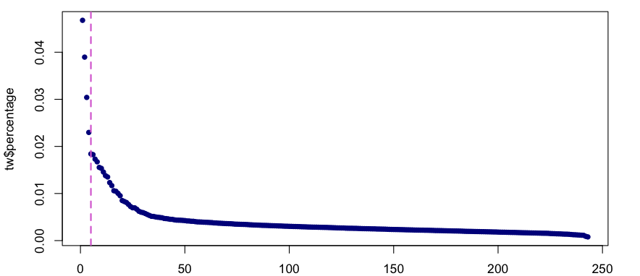
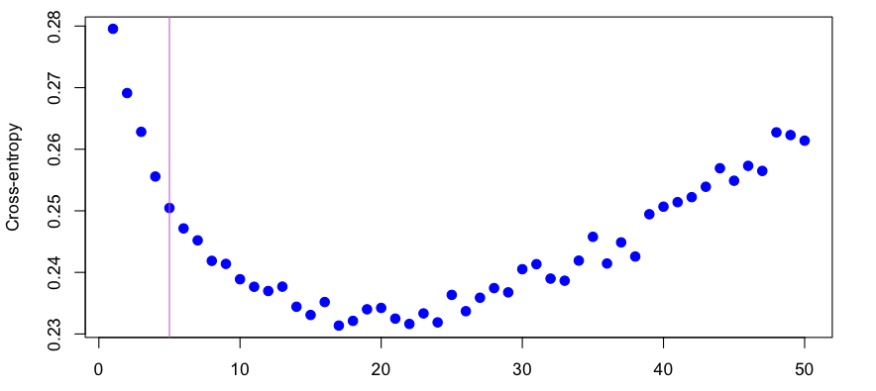
PCA
n=5
Cross-entropy
n=5
Western
Appalachian
Eastern
p=0.19
p=0.01
p=0.70
Linearized genetic distance
Log10(geographic distance)

Slide 5
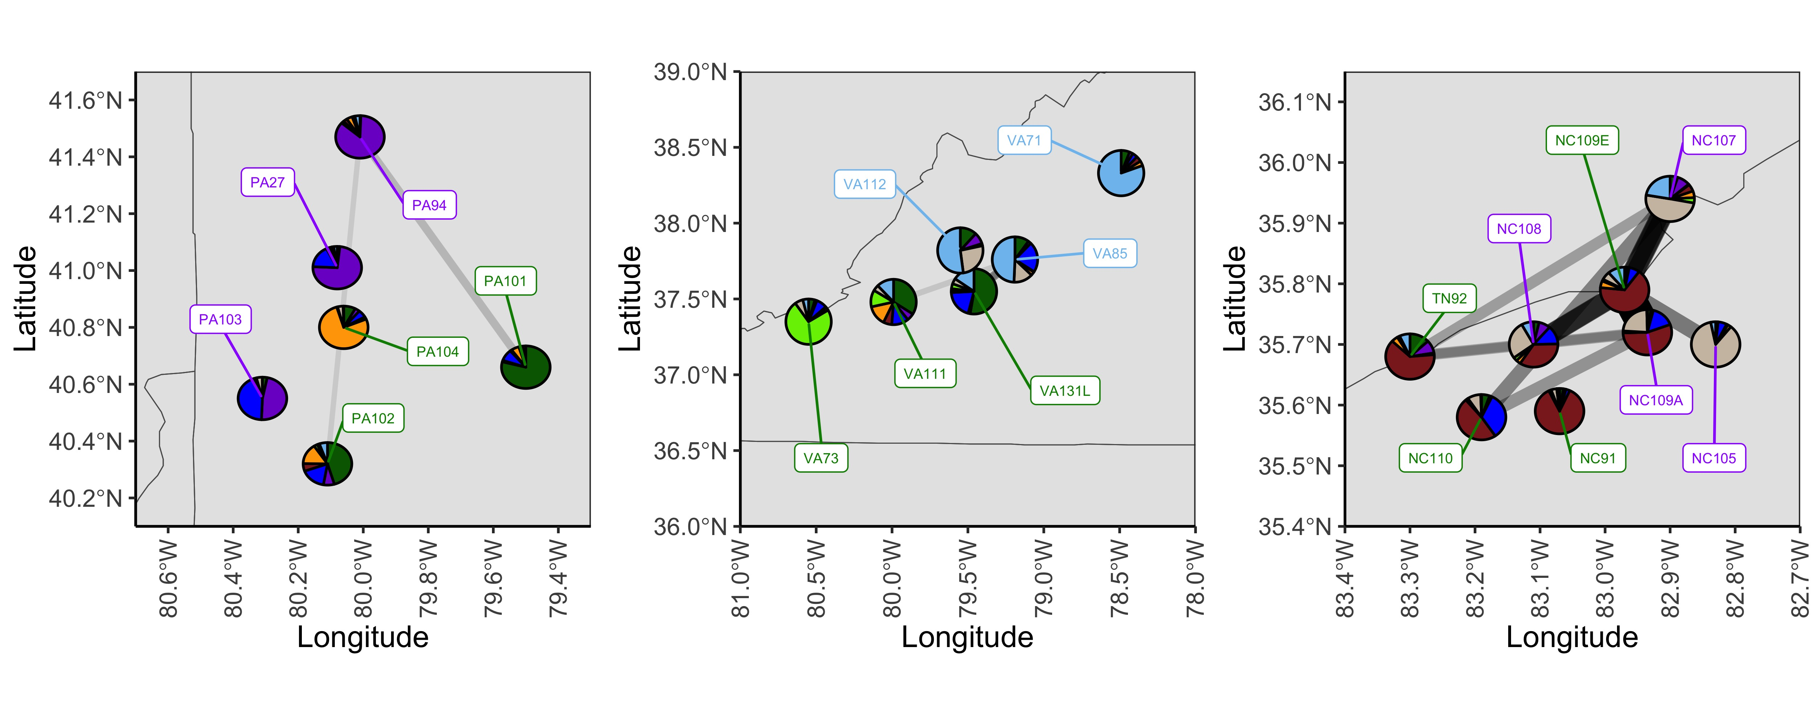

Slide 6
80% missing SNP filter – 50% missing individual filter

Slide 7
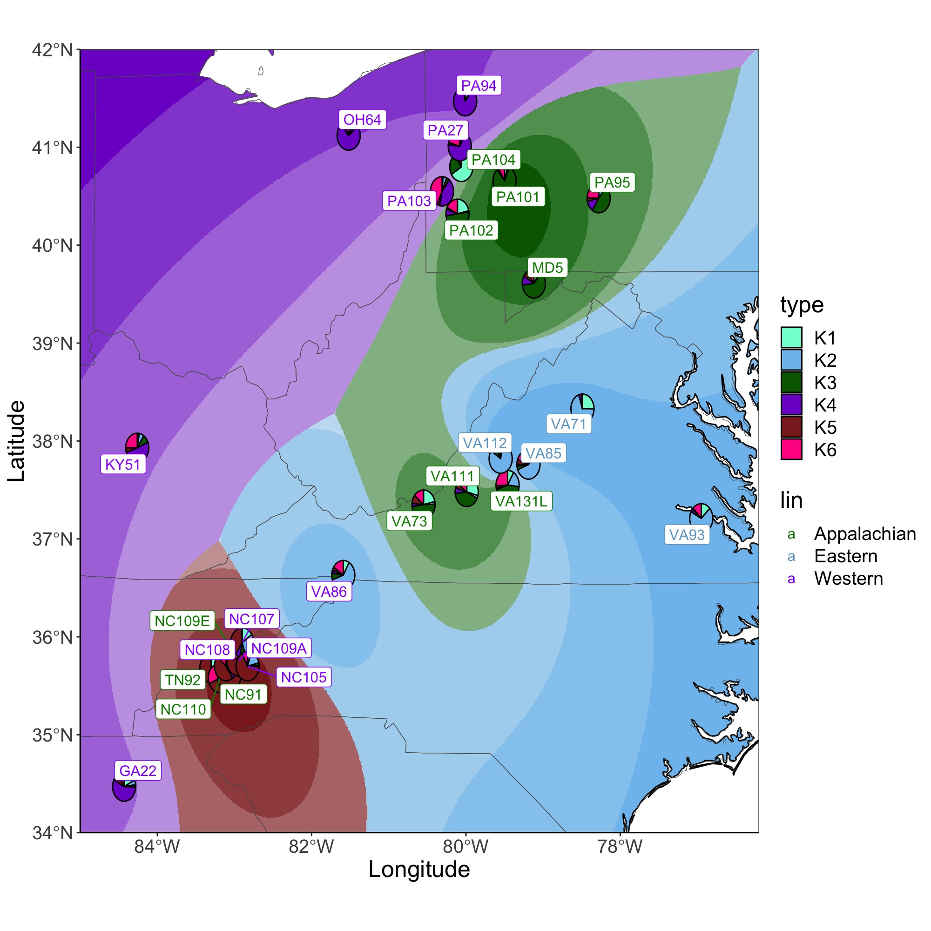

Slide 8
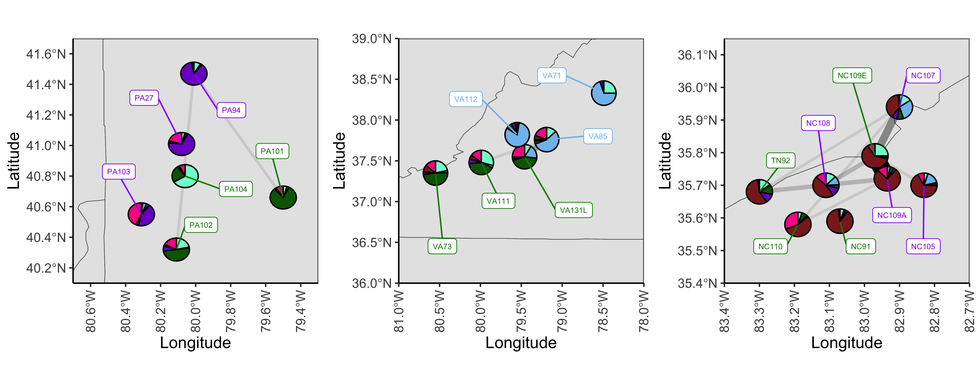
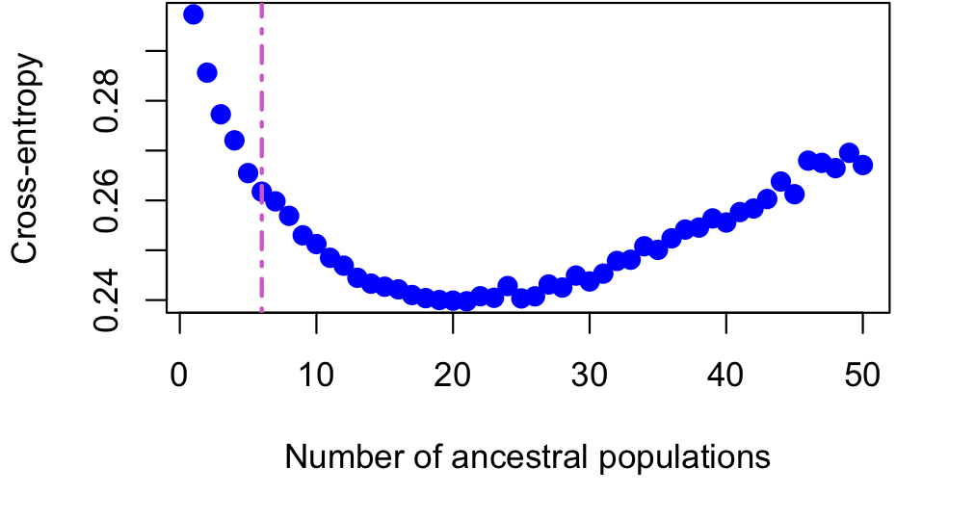
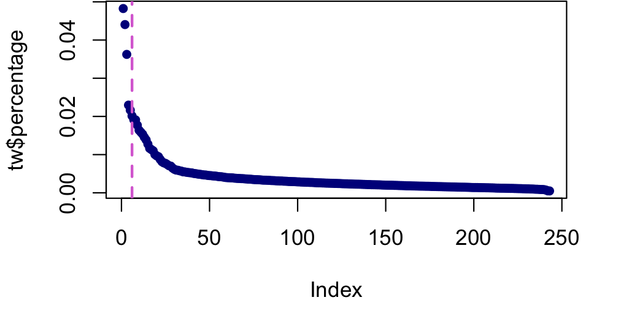
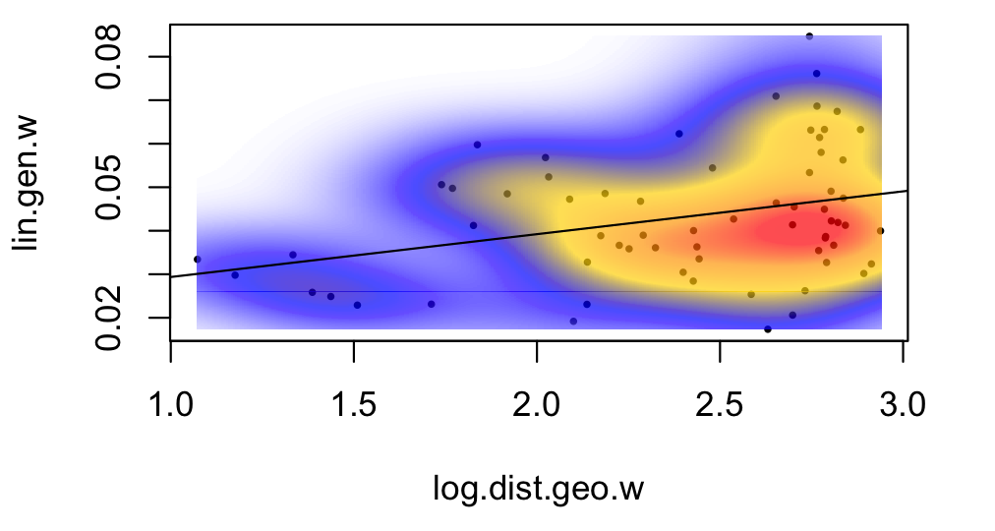
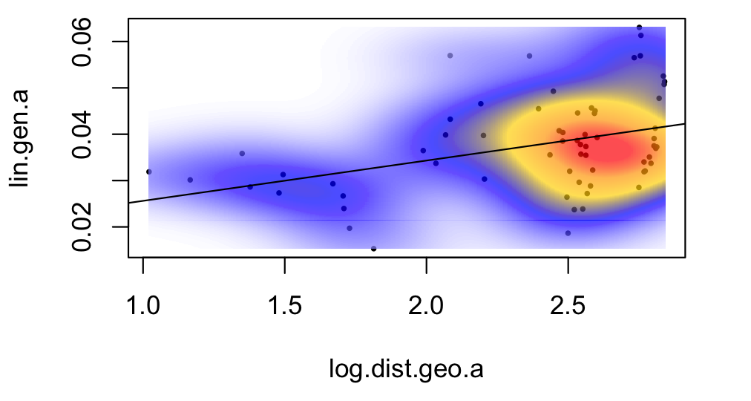
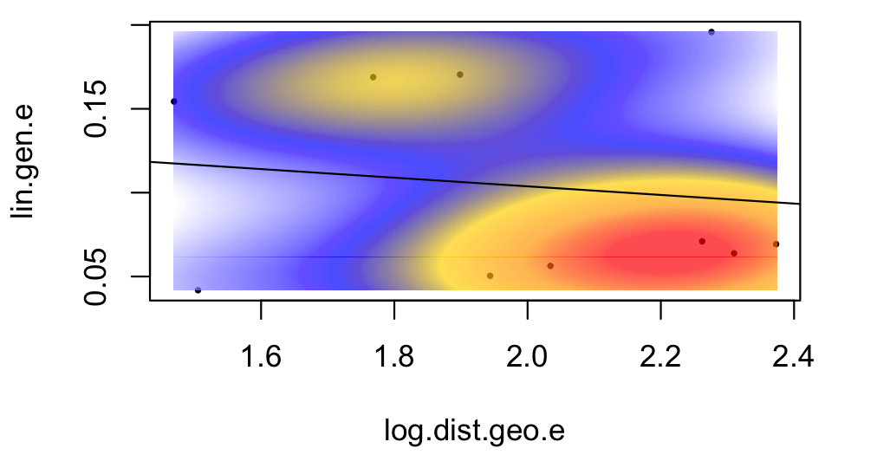
Cross-entropy
K=6
PCA
K=6
Western
Appalachian
Eastern
p=0.01
p=0.001
p=0.43

Slide 9
Demographic inference patterns by SNP missing percentage

Slide 10
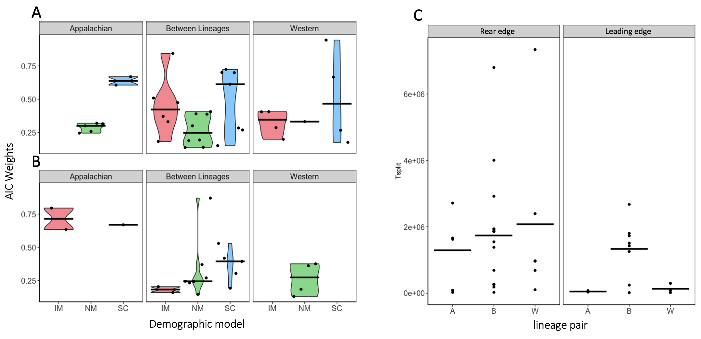
OG 867 SNP set (72.5% missing)
Model score = (max(∆AIC) - ∆AIC) / max(∆AIC)
AIC_{W} = exp(-(AIC – min(AIC))/2) / Σ_{exp(-(AIC – min(AIC))/2)}

Slide 11
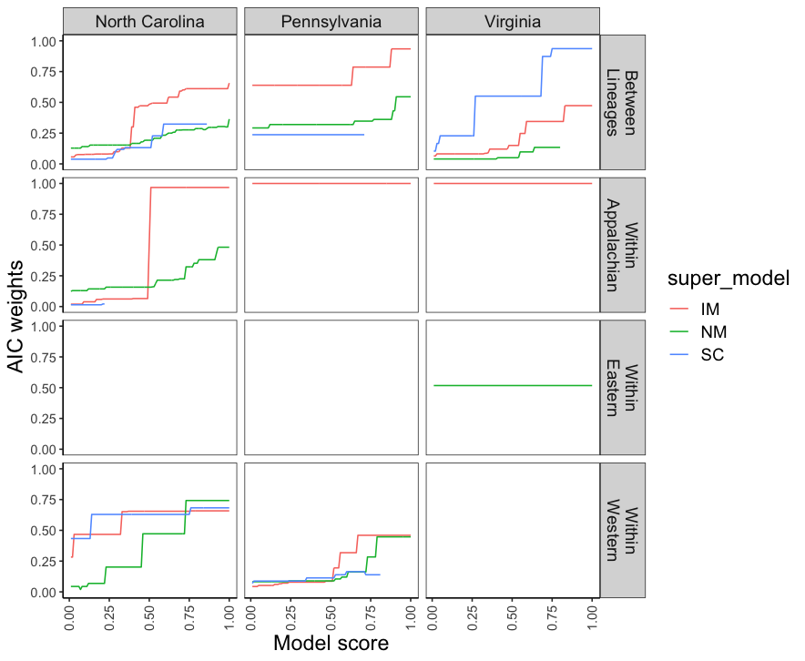
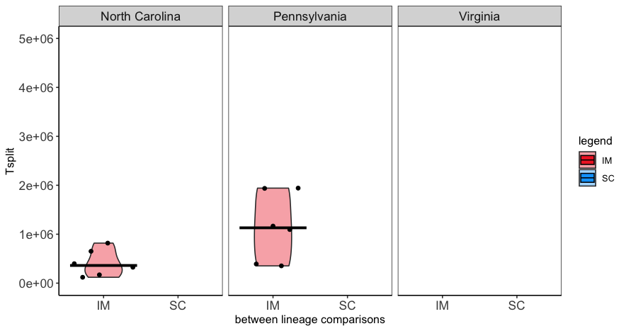
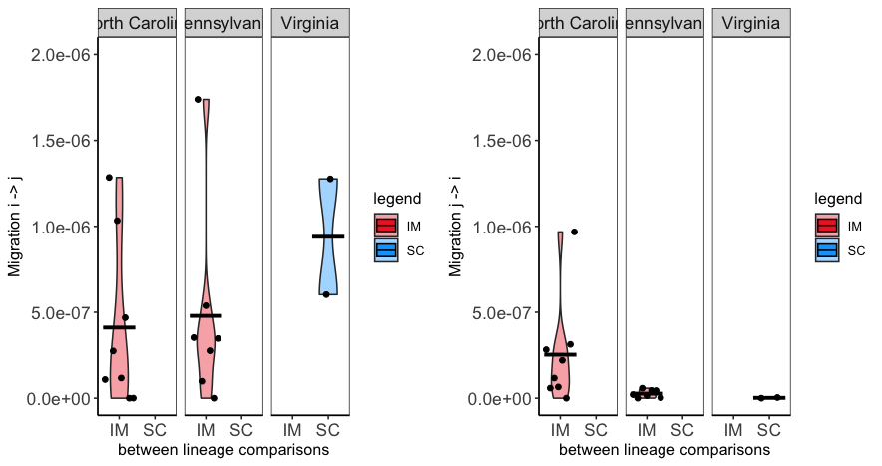
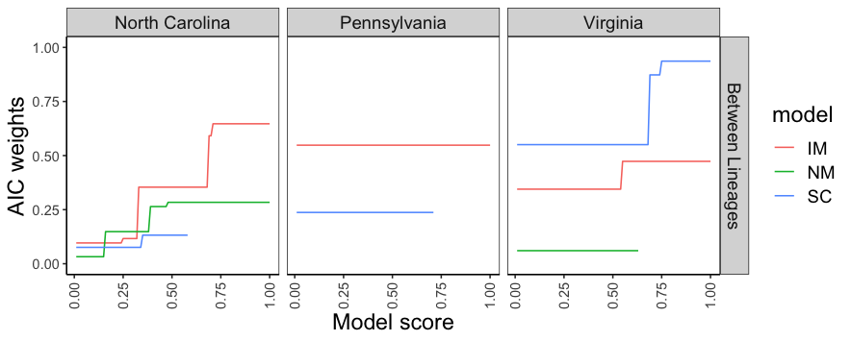
65% missing SNP
No ‘super models’
Model score = (max(∆AIC) - ∆AIC) / max(∆AIC)
AIC_{W} = exp(-(AIC – min(AIC))/2) / Σ_{exp(-(AIC – min(AIC))/2)}

Slide 12
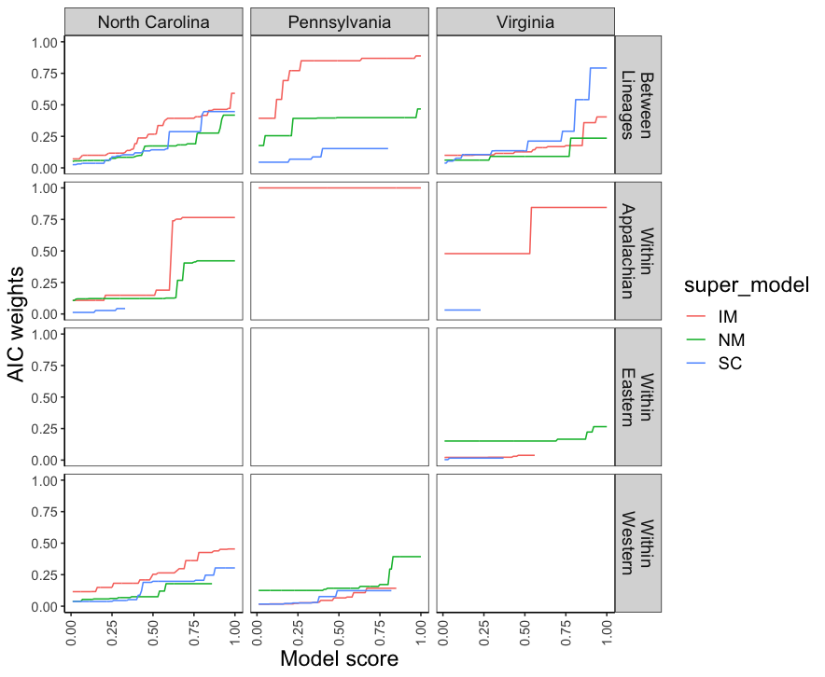
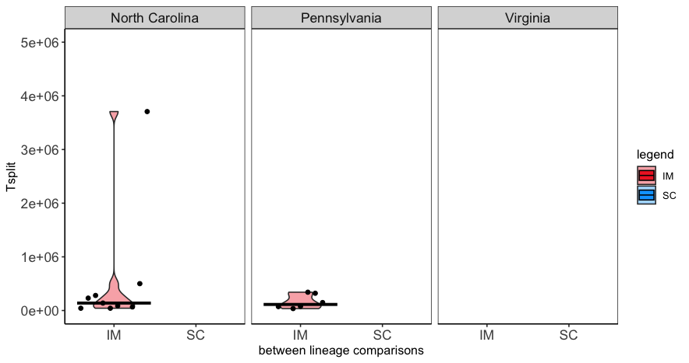
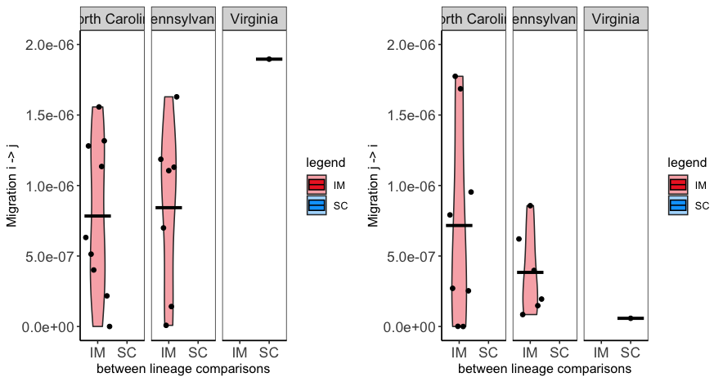
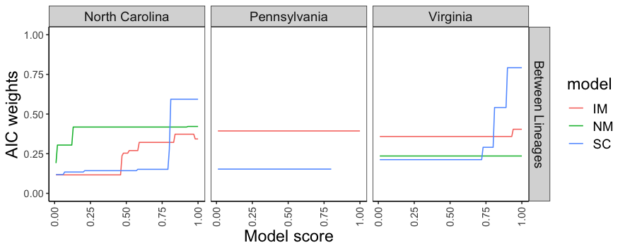
80% missing SNP
No ‘super models’
Model score = (max(∆AIC) - ∆AIC) / max(∆AIC)
AIC_{W} = exp(-(AIC – min(AIC))/2) / Σ_{exp(-(AIC – min(AIC))/2)}

Slide 13
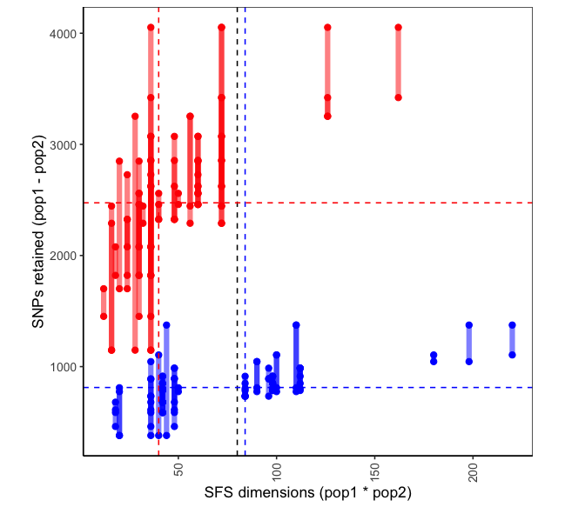
2N² ~ 6.3²
2N² ~ 9²
2N² ~ 9.2²

Slide 14
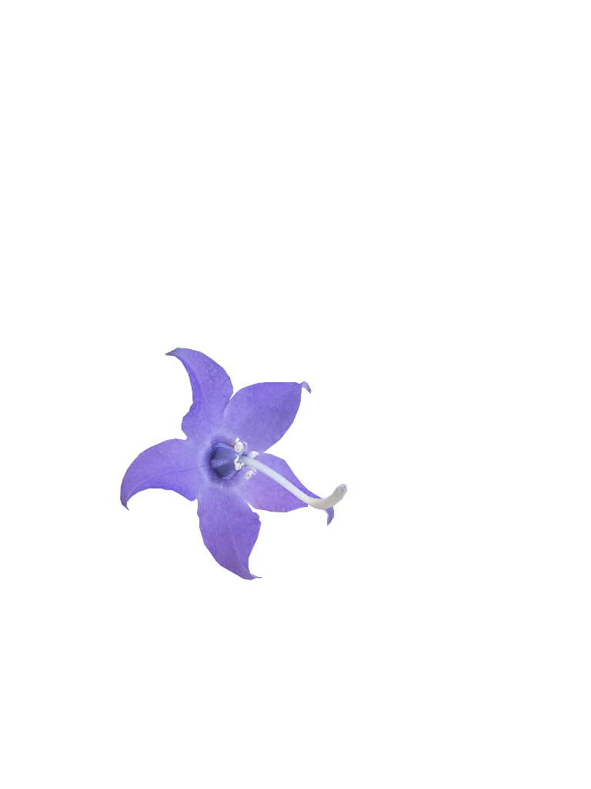
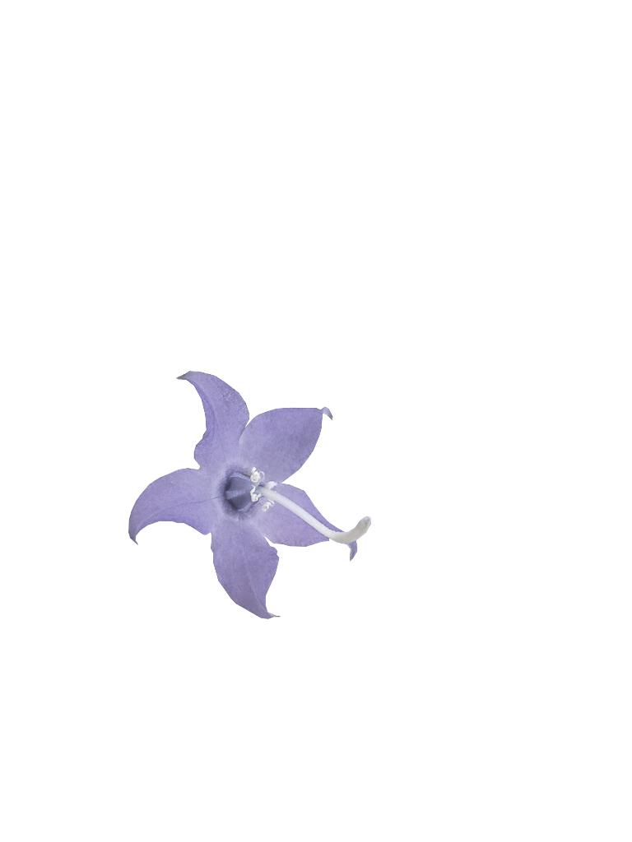
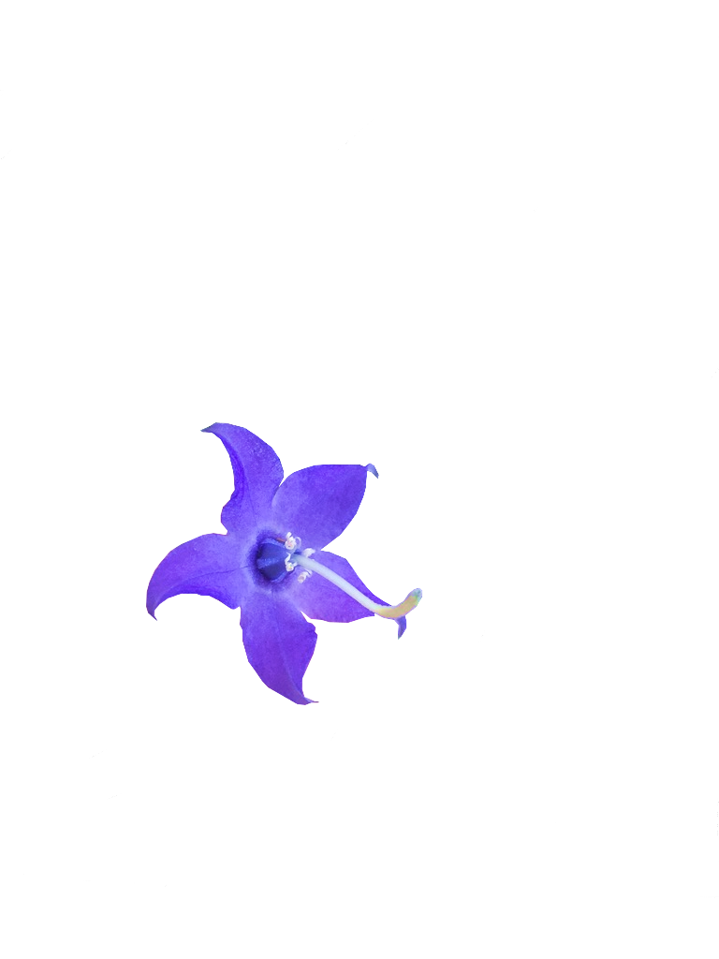
A
time
B
IM
IM_{AE}
NM
NM_{AE}
SC
SC_{AE}
AM
AM_{AE}
time
IM_{B}
IM_{AEB}
NM_{B}
NM_{AEB}
SC_{B}
SC_{AEB}
AM_{B}
AM_{AEB}
IM 2C
IM 2C_{AE}
SC 2C
SC 2C_{AE}

Slide 15
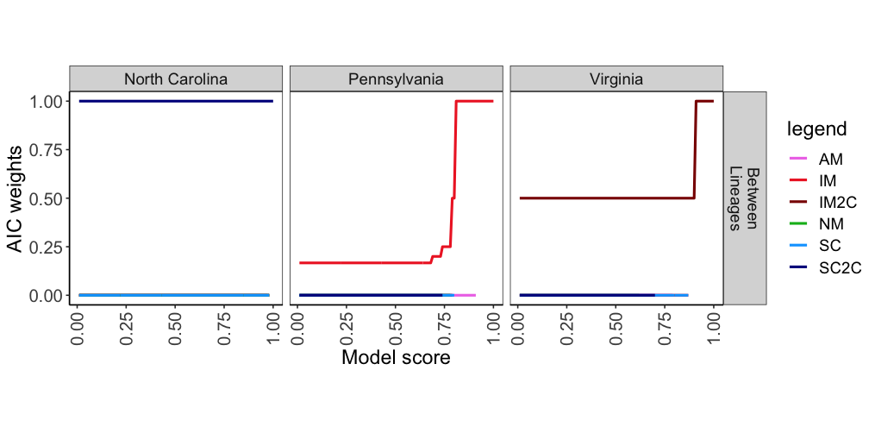
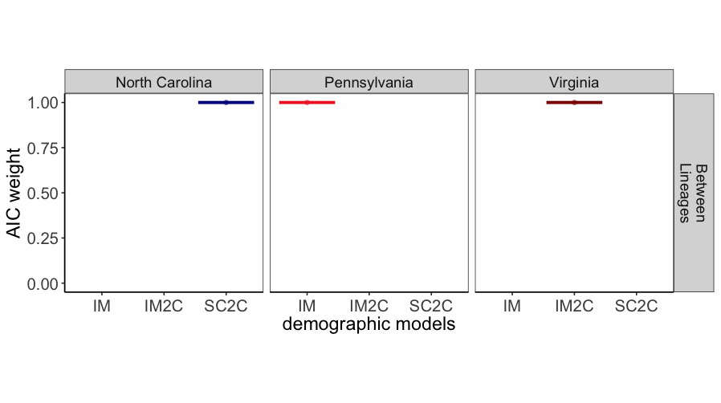
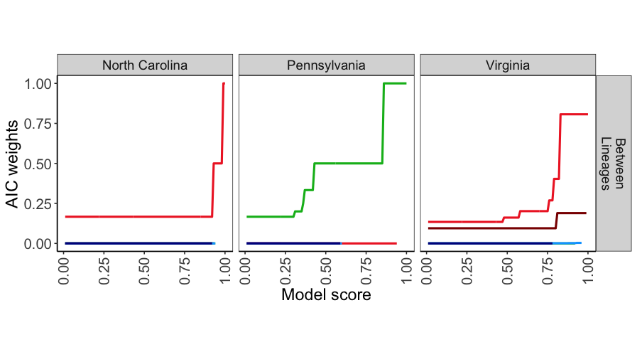
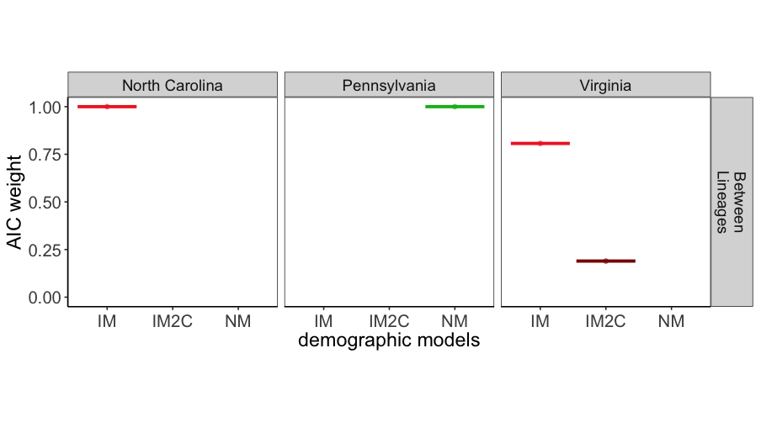
65% missing
80% missing

